Slide 1
Chongqing University of Technology
ATAI
Advanced Technique of Artificial Intelligence
Chongqing University of Technology
Time-Stamped Language Model:
Teaching Language Models to Understand the Flow of Events（2021_NAACL）
Hossein Rajaby Faghihi Michigan State University
rajabyfa@msu.edu
Parisa Kordjamshidi Michigan State University
kordjams@msu.edu
2021.8.29 • ChongQing
Reported by Le le Duan
Code & dataset:https://github.com/HLR/TSLM

Slide 2
Chongqing University of Technology
ATAI
Advanced Technique of Artificial Intelligence
Chongqing University of Technology
1.Background
2.Method
3.Experiments

Slide 3
Background
Tracking entities throughout a procedure described in a text is challenging.
Roots absorb water from soil;
The water flows to the leaf ;
Light from the sun and CO2 enter the leaf ;
The water, light, and CO2 combine into a mixture;
Mixture forms sugar.
In recent research, different approaches are taken to address procedural reasoning based on language models using QA formulations.
Intuition that attributes of entities can be retrieved based on the current and previous steps:
DynaPro (Amini et al., 2020)
KG-MRC (Das et al., 2018)
However, this intuition is contradicted in some scenarios.

Slide 4
Method
Firstly, we propose to formulate this task as a question answering problem.
Secondly, we propose a Time Stamped Language Model (TSLM model) to encode event information in LMs architecture by introducing the timestamp encoding.
(1)Roots absorb water from soil;
(1)The water flows to the leaf ;
(1)Light from the sun and CO2 enter the leaf ;
(2)The water, light, and CO2 combine into a mixture;
(3)Mixture forms sugar.

Slide 5
Method
Problem Definition

Slide 6
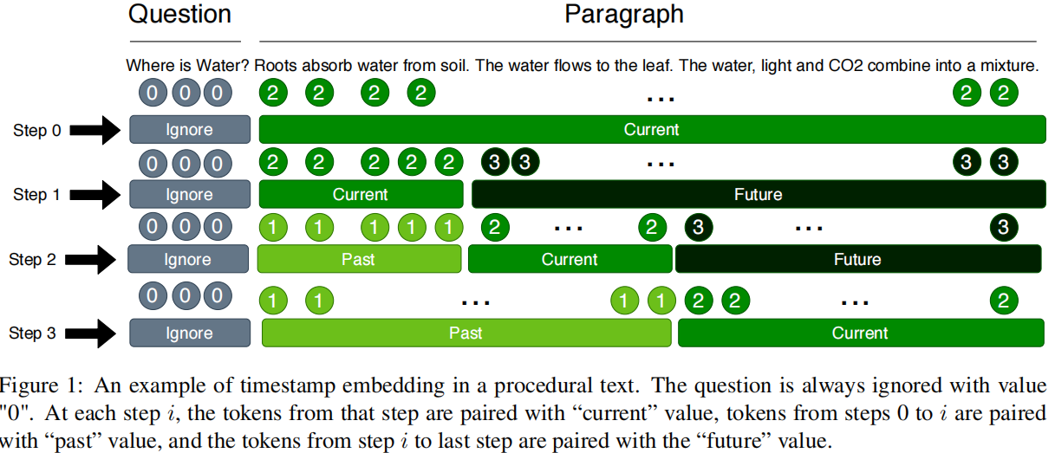
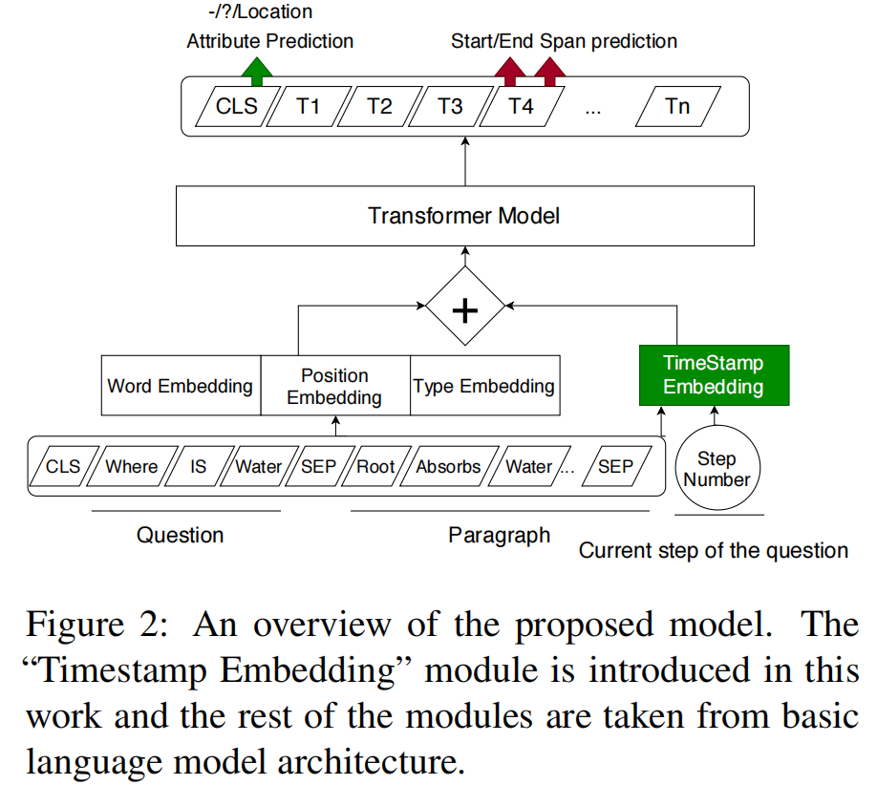
Method
Proposed Procedural Reasoning Model
QA Setting
Timestamp Embedding
Modeling step-dependency:

Slide 7
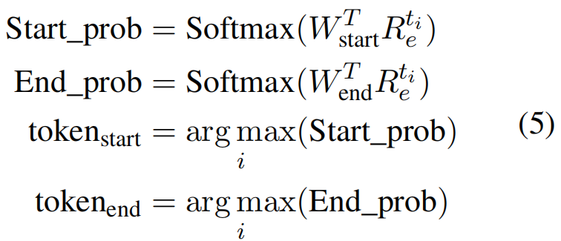
Method
Proposed Procedural Reasoning Model
Status classification
An entity can not be created if it has been already destroyed
An entity cannot be created/destroyed twice in a process
Span prediction
softmax over tokens of noun phrases

Slide 8
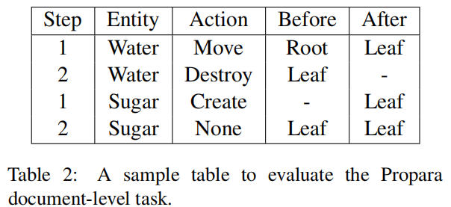
Experiment
Dataset:
Propara
Sentence-level
• Cat1 Is e created (destroyed/moved) during the process?
• Cat2 When is e created (destroyed/moved) during the process?
• Cat3 Where is e created (destroyed/moved from or to) during the process?
Document-level
• What are the Inputs? Which entities existed before the process began and do not exist after the process ends.
• What are the Outputs? Which entities got created during the process?
• What are the Conversions? Which entities got converted to other entities?
• What are the Moves? Which entities moved from one location to another?
The document-level evaluation requires models to reformat their predictions in a tabular format as
shown in Table 2.
NPN-Cooking

Slide 9
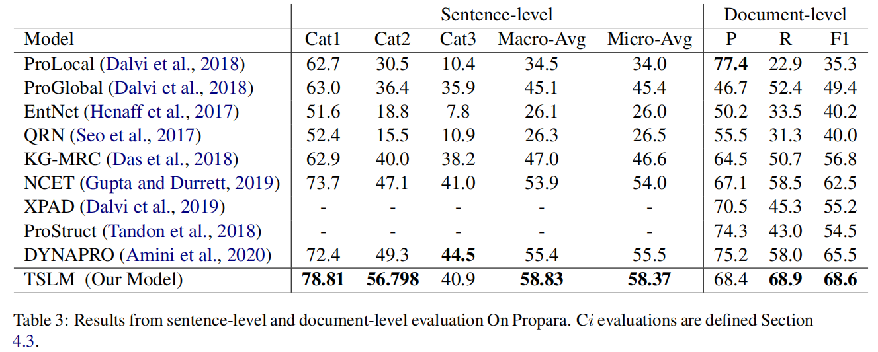
Experiment
• Cat1 Is e created (destroyed/moved) during the process?
• Cat2 When is e created (destroyed/moved) during the process?
• Cat3 Where is e created (destroyed/moved from or to) during the process?

Slide 10
Experiment

Slide 11
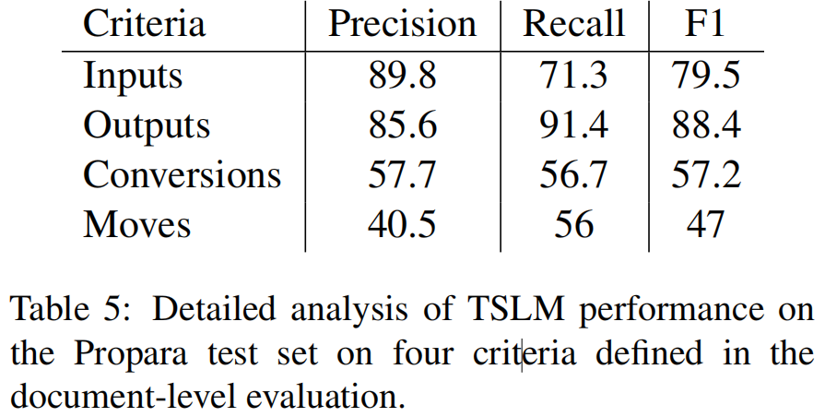
Experiment

Slide 12
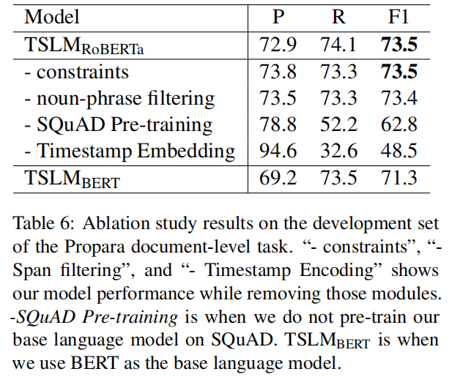
Experiment

Slide 13
Chongqing University of Technology
ATAI
Advanced Technique of Artificial Intelligence
Chongqing University of Technology
Thank you!

